Slide 1
THINGS TO BRING
TRACKERS for SHOW
Solar Cells to break
A balloon partially inflated

Slide 2
NIBBB.ORG Pico Balloon Presentation
Northern Illinois Bottlecap Balloon Brigade
September 2022
Michael Seedman

Slide 3

Balloons are not great for
lifting Houses

Slide 4
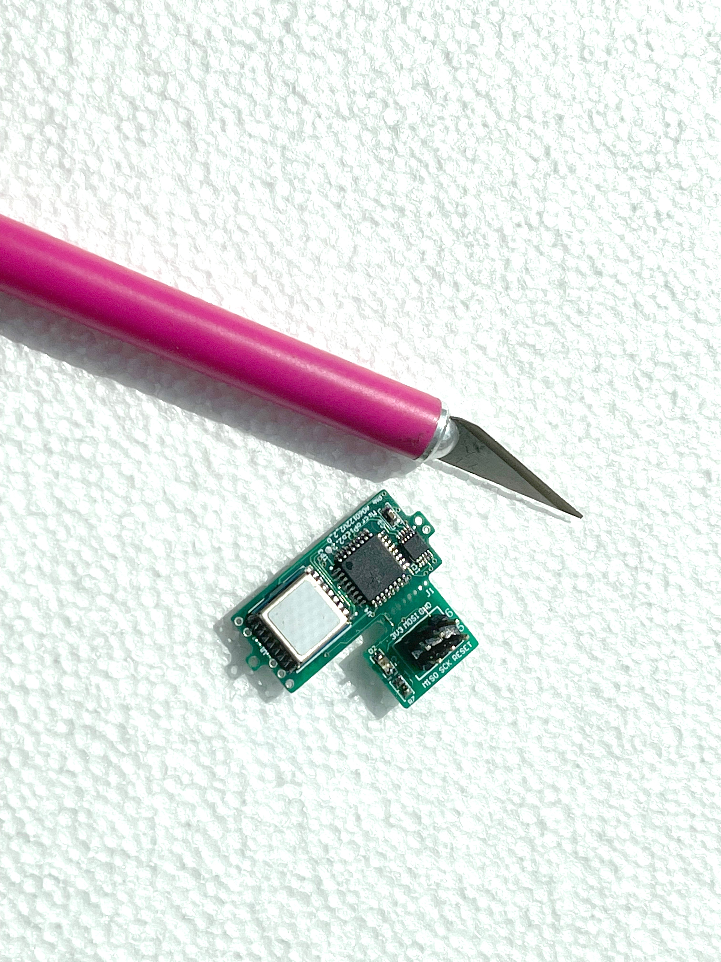
But they are great for lifting microprocessor controlled, GPS carrying, 10mW transmitters that can be heard 10,000 miles away

Slide 5

Fly and track a small mylar balloon around the world
Party balloon
a tracker
solar panels
33’ dipole antenna
Notes:
Overall, The way we string these balloons – The Balloon, the top half of the 20 meter dipole, the tracker and solar cells, and the bottom half of the 20 meter dipole
We weigh the payload, add about 6 grams of positive lift, and fill about 30% of the balloon with Hydrogen – our lifting gas. Helium works too. We weigh the balloon until it shows about -7 grams. We find a park – a big park. Even a big golf course on top of a hill where there are no trees, then we get this big 30 foot pole with a device that lets go of the balloon attached at the top

Slide 6
Ham Radio Tracking
Notes:
The balloon ascends – pretty much the higher the better. We started with flights that flew about 20,000 feet. Our latest flight is flying these very skies at 47,000 feet and has been up there for about 15 days.
The tracker sends two WSPR messages – one on the 2’s – and one on the 4’s.
All the messages are 50 bits long – not bytes, not kilobytes, etc. They take TWO minutes to send, which makes the speed POINT FOUR BAUD.
This a great example of NARROW BANDWIDTH, SLOW DATA.
The first message is a standard WSPR packet, with your HAM call, a 4 digit madenhead location, altitude. The second message is a Balloon packet that adds to the accuracy of the madenhead location and altitude, along with some telemetry information
Ham radio operators all over the world have their radios tuned to 14.095, and their computers running WSJT in WSPR mode.
The program listens for packets and when they receive them, they post the packet to a database.
Front end programs read the database, and post the location and other data to website maps.

Slide 7
How could this possibly be legal?
FAA reg part 101 -
Weighs under 4 pounds
Density less than 3oz per square inch
Uses a rope with a breaking strength of less than 50 lbs
Notes:
So, as many things like this, the government doesn’t like it when people have fun. So could they possibly let us do this?

Slide 8
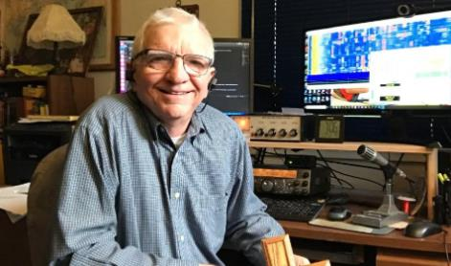
In 2019 I saw Ken Daniel’s Pico Balloon presentation. I knew I had to try this. Two years later I shared the idea with Cary Willis, KD9ITO and the Northern Illinois Bottlecap Balloon Brigade – NIBBB.ORG, was born
Ken Daniel - K9YO
Notes:
ORIGINALLY, I FOUND OUT ABOUT THIS FROM A PRESENTATION much like this one by a guy named KEN DANIEL. It was 2019, and I knew I was going to fly a balloon. BUT it took me a full 2 years to come back around to giving it a try. I was speaking to Cary, KD9ITO and he was all in. We put a small group of people together and started having meetings and planning for a launch.

Slide 9
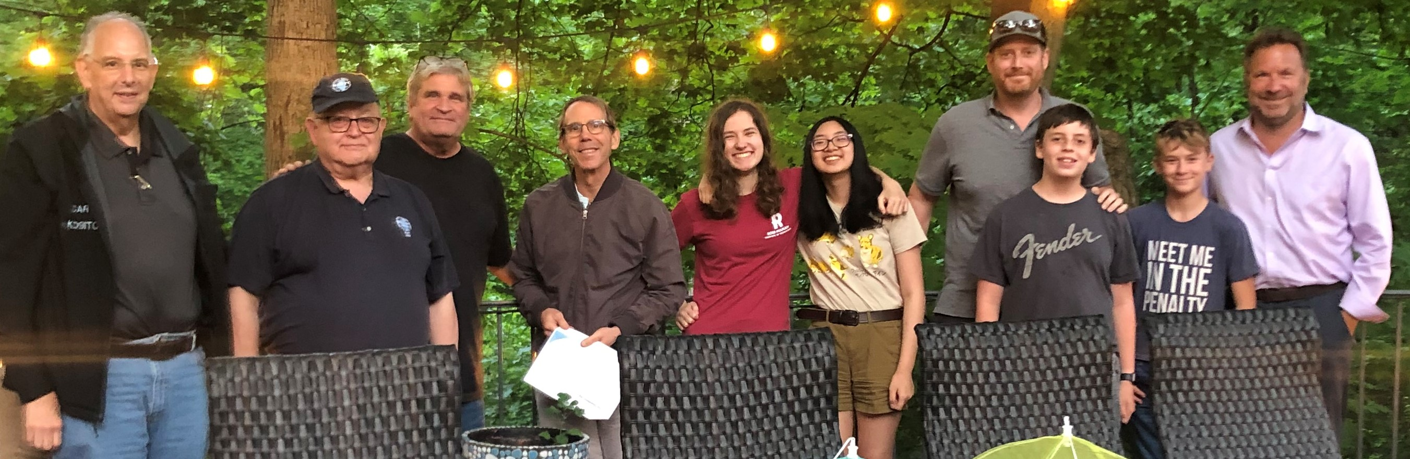
First Meeting of the NIBBB was June 2021
From left to right, Cary Willis KD9ITO, Burt Krain KR9T, Michael Seedman AA6DY, David Kaplan, Elizabeth Ziemer KD9ORR, Natalie Tran, Bill Fiely, Henry Fiely KD9SRZ, Noah Berg KD9RDT, and Bob Berg KD9RDU
Notes:
Here’s the group from our first meeting in June, 2021.

Slide 10
Our Questions from June 2021 – our first meeting:
Are we flying a Pico or a Nano size Balloon?
Which Bands, Frequencies, and Modulations should we be using for our first set of launches?
2M, 20M, 30M or other(s)?
APRS, WSPR, or other?
What type and where do we buy the balloons?
How big and what’s it made of?
Do we buy material and a sealer, or pre-made balloons?
What type and where do we buy the gas?
Helium or Hydrogen?
Rent or buy Tanks, regulators, and hoses?
How do we calculate the amount of gas we use at launch?
How do we meter the correct amount of gas?
Where is a nice, big field we could use for launching our balloon(s)?
How far do these balloons travel?
When is the best time of year to launch a balloon?
How do we track these balloons?
What software do we run on the microprocessor on the transmitter?
How do we power the transmitter? What criteria do we use to choose?
Solar Cells plus Super Capacitors?
Batteries? – if so, what kind of batteries?
Should we take pictures and document our adventure so we can share it with family and friends?
Are there specific rules we need to follow?
Yes there are. We are flying under FAA 101 exemption rules.
Notes:
Questions:
Frequency, protocol, gas, launching, balloons, solar cells, trackers, and on and on. We knew NOTHING about what were were planning to do.

Slide 11
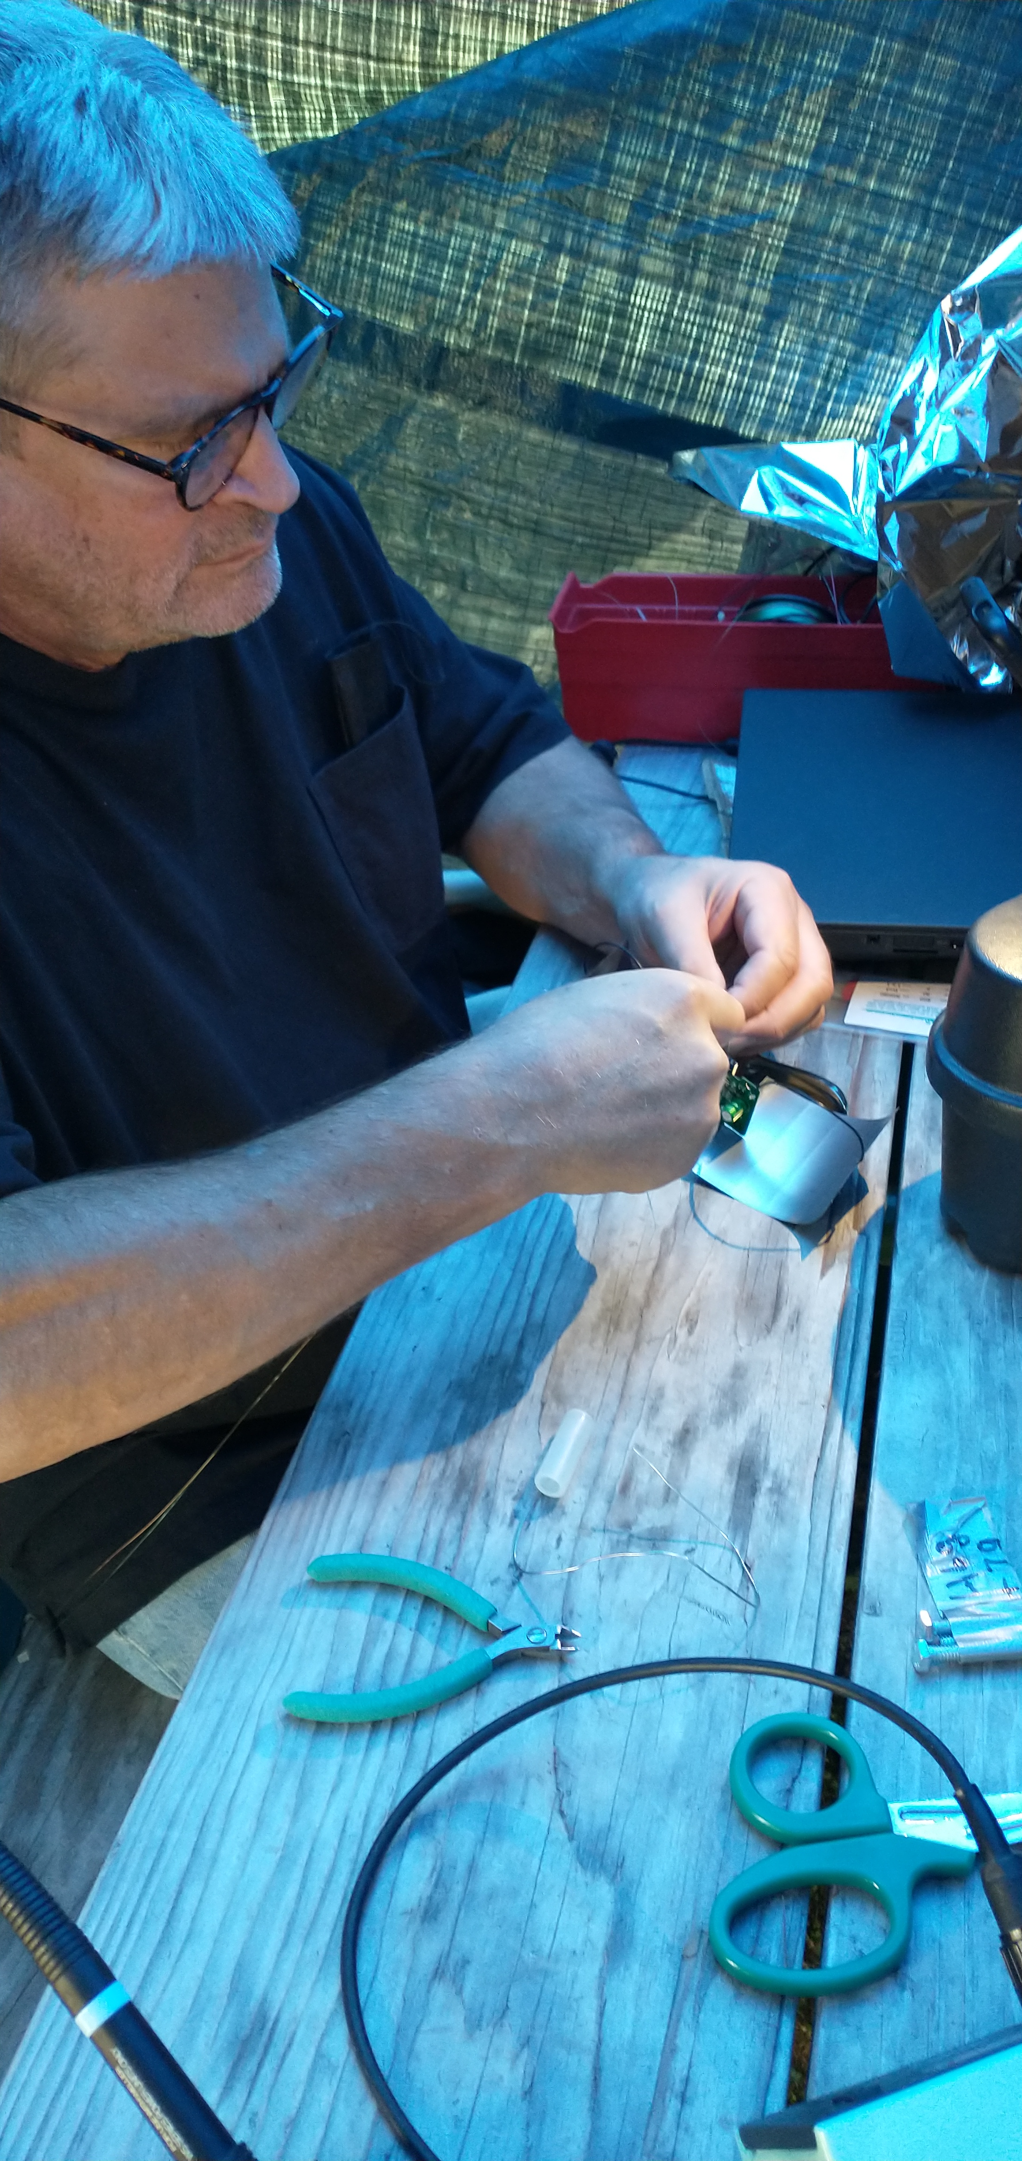
First launch
September, 2021
Notes:
We met at Glencoe beach for the first launch.
Brought a Tent, a generator, all the supplies, soldering equipment, a tank of helium, wire for an antenna, lots of tools and assembled a balloon package.

Slide 12
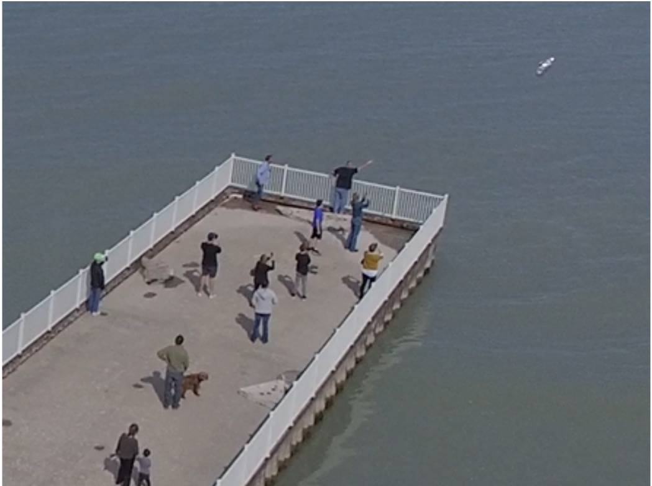
Glencoe Beach
We never heard from it again
Notes:
We walked down what I remember as a long, long trail down this humongous mountain, across this huge desert of hot sand, to a pier. We walked out to the end of the pier. The wind was blowing and the balloon was flapping. We let it go, the tracker bounced off the water – I’m sure it didn’t get wet, and took off. It climbed so high so quickly, that the board looked like a propeller spinning at full speed.
We never heard from that balloon again.

Slide 13
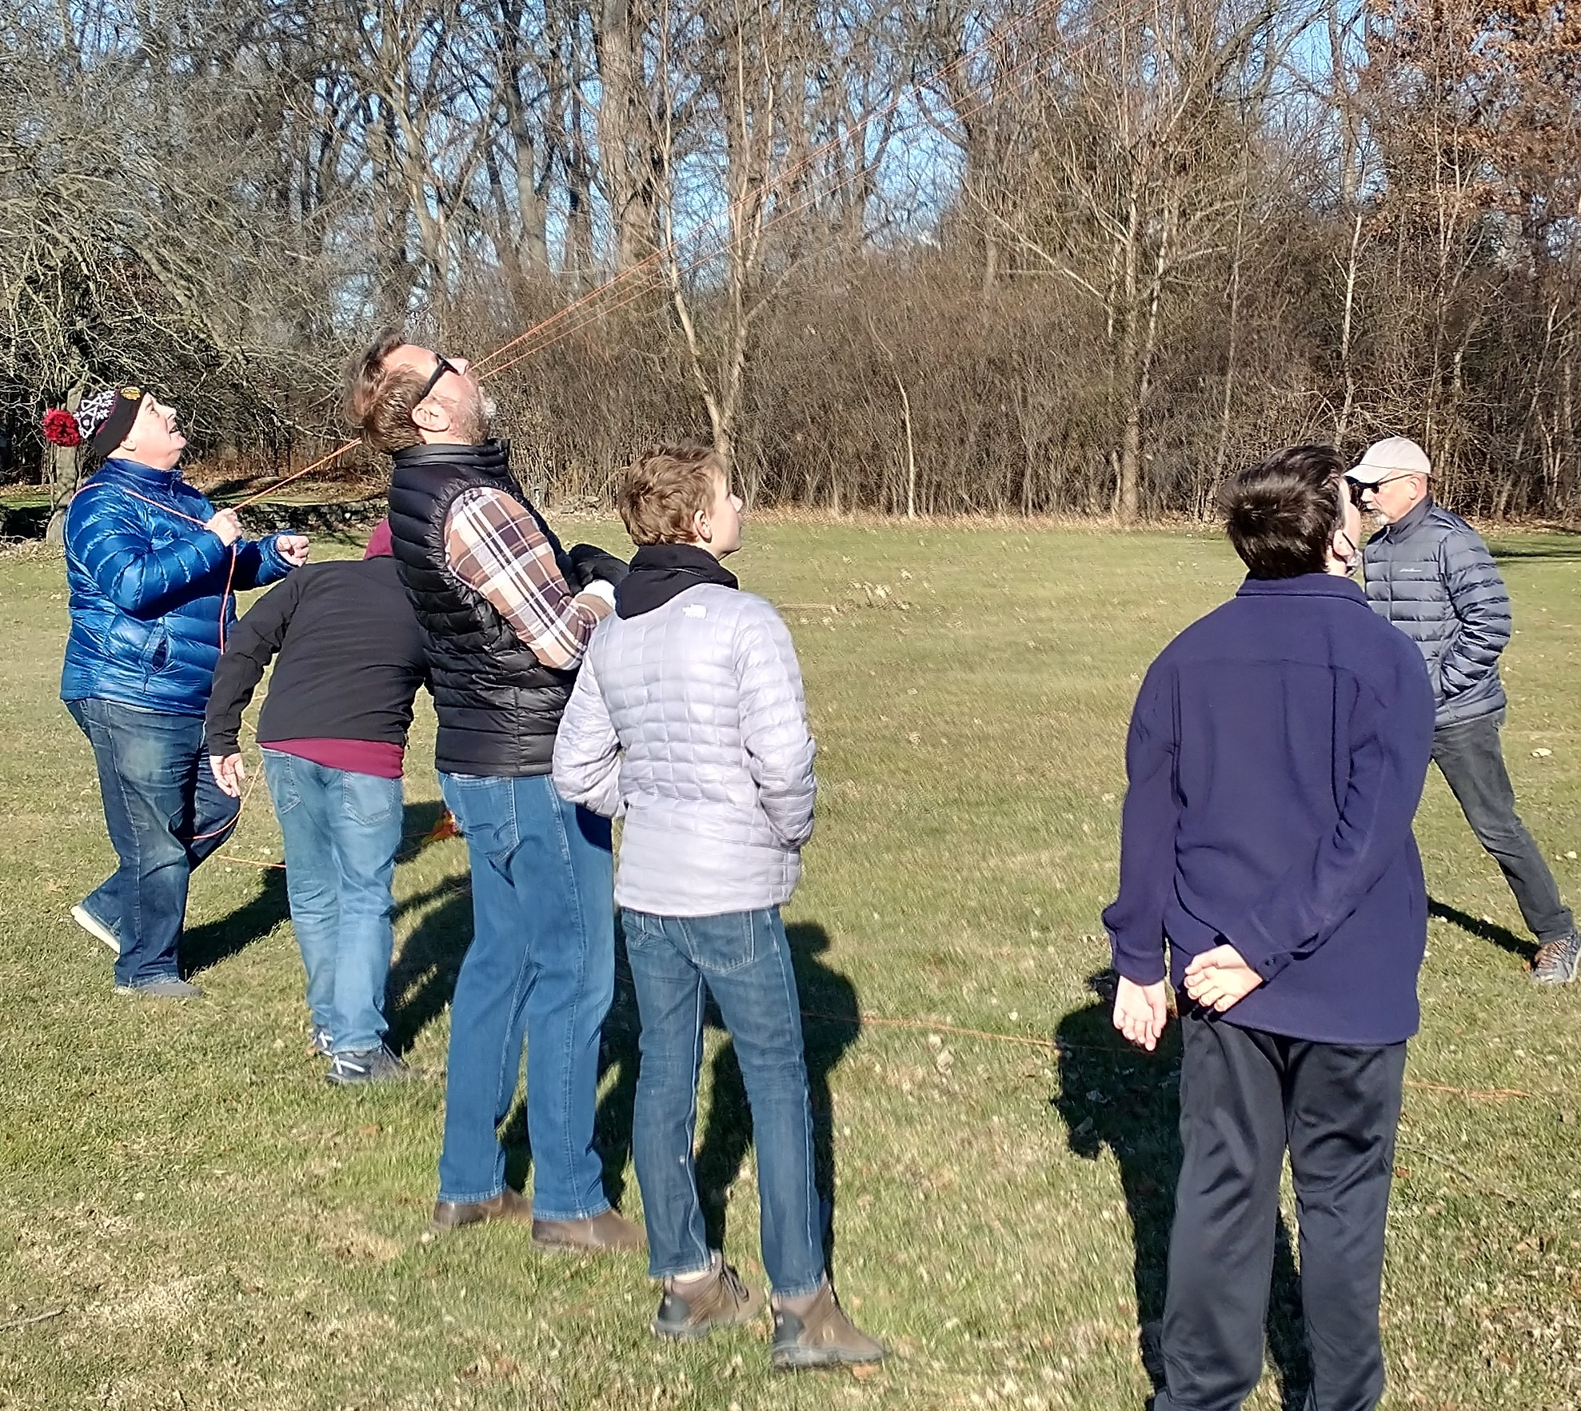
Since our first launch, our group has flown 24 balloons
Notes:
This is the look on all the participants faces

Slide 14

6 balloons ended up in trees
(we came up with a fix for this)
Notes:
This happened way too much

Slide 15
Don, KK9H snagging a balloon in a tree.
Notice the intensity.

Slide 16
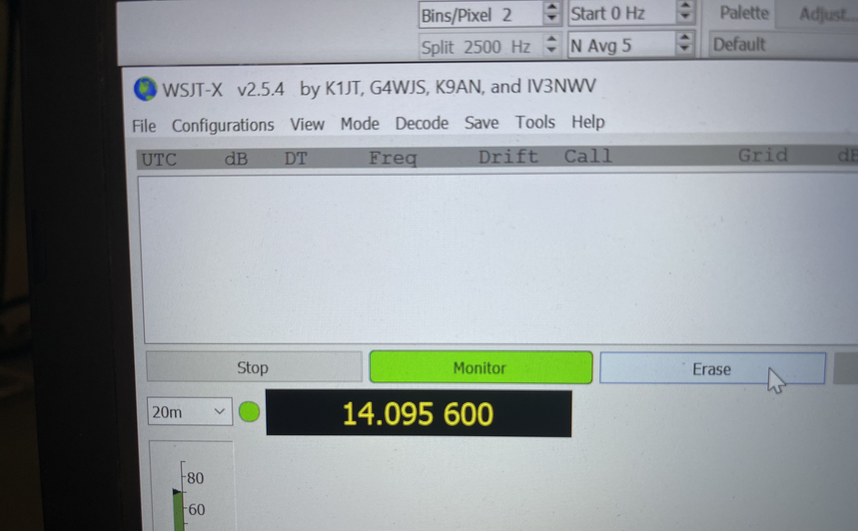
6 balloons that
never said Hello
(we’re still working on a fix for this)
Notes:
The problem here is we NEED to transmit our packets and SOMEONE NEEDS to hear the packet.

Slide 17
BUT along the way,
WE ALSO HAD

Slide 18
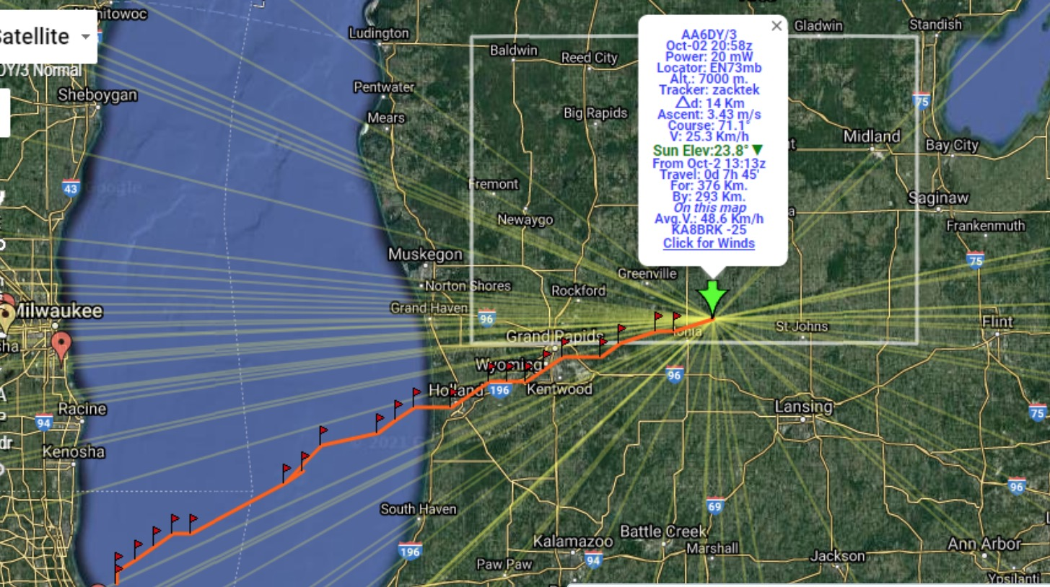
8 balloons that cruised the United States

Slide 19
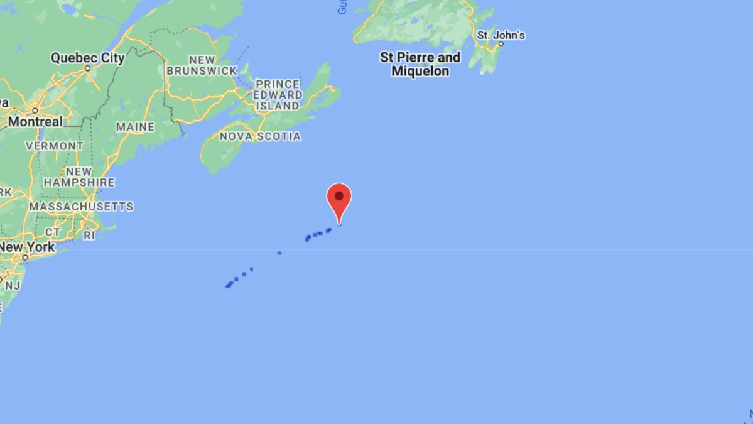
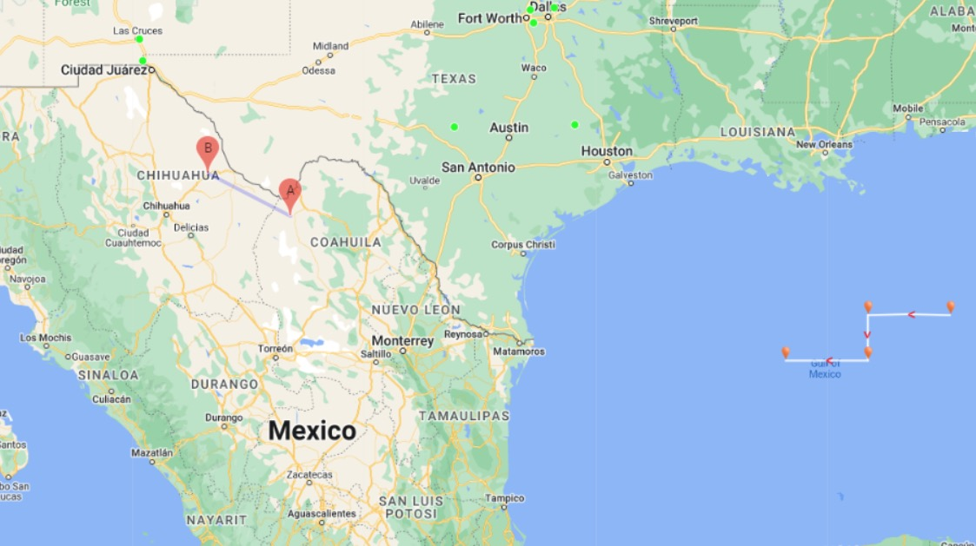
8 balloons that left the United States

Slide 20
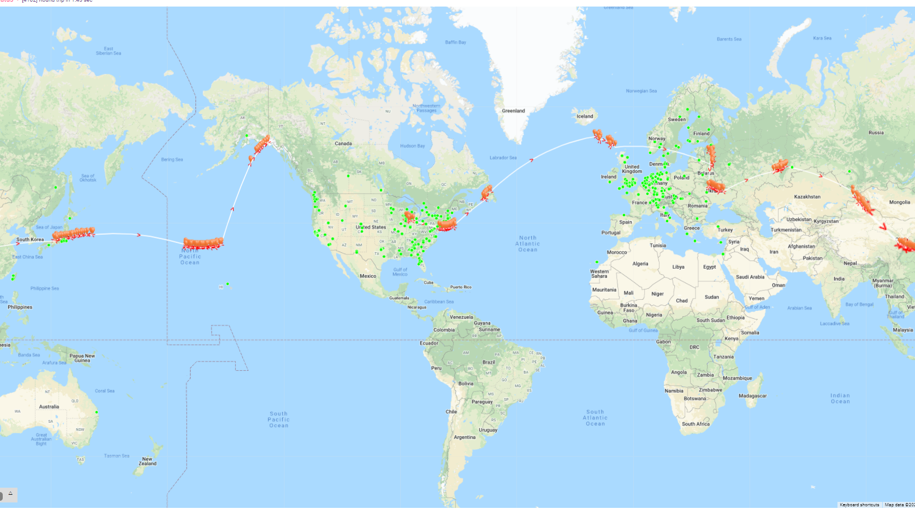
And FOUR balloons that almost made it around the world

Slide 21
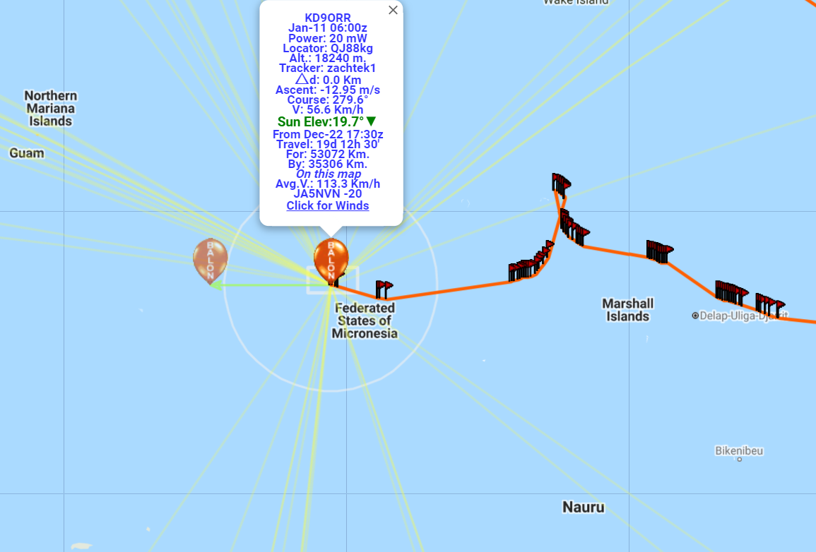
Our longest flight, 19 days, made it around the world, almost to Hawaii, then turned around
And went to the Marshall islands for 8 days

Slide 22
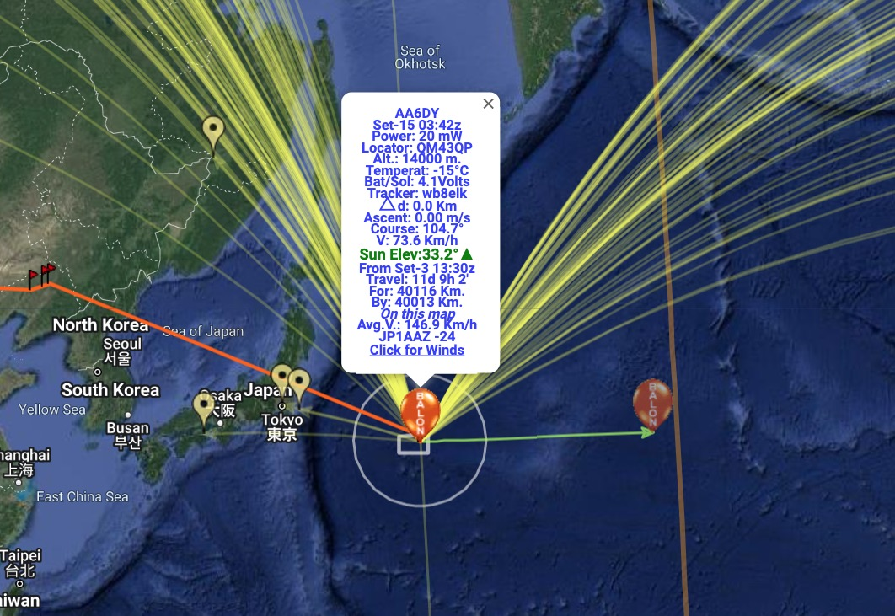
Yesterday evening, AA6DY was off the coast of Japan heading back to the United States at 47,000 feet

Slide 23
Lets Talk BALLOONS
Notes:
So NOW SOME DETAILS

Slide 24
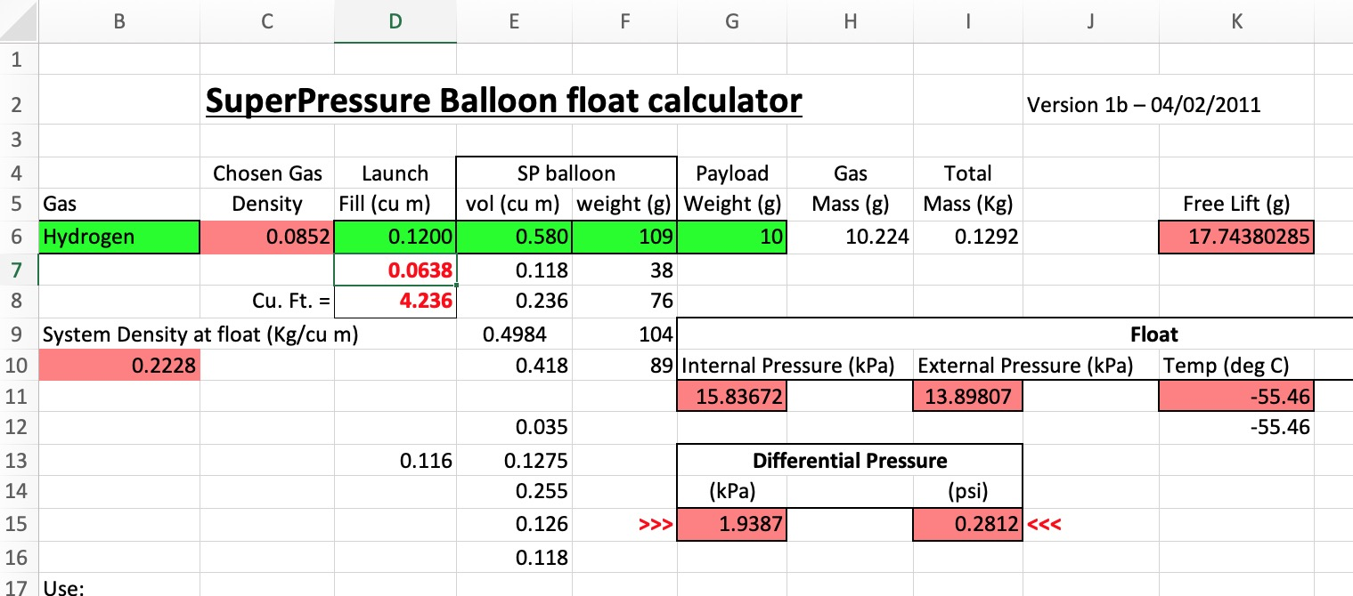
Balloon math
Over the year we’ve been able to increase the float altitude from around 20,000 feet to 46,000 feet.
Why is this so important?
We have a spreadsheet whose inputs are:
Weight of the balloon
Type of lifting gas
Weight of payload
Volume of balloon when full
Free lift
We’ve found that although the weight of the payload is a factor, the volume of the balloon makes a much bigger difference
Notes:
We found that between weight and volume, VOLUME IS REALLY IMPORTANT. BIGGER BALLOONS make up for a bit more payload weight

Slide 25
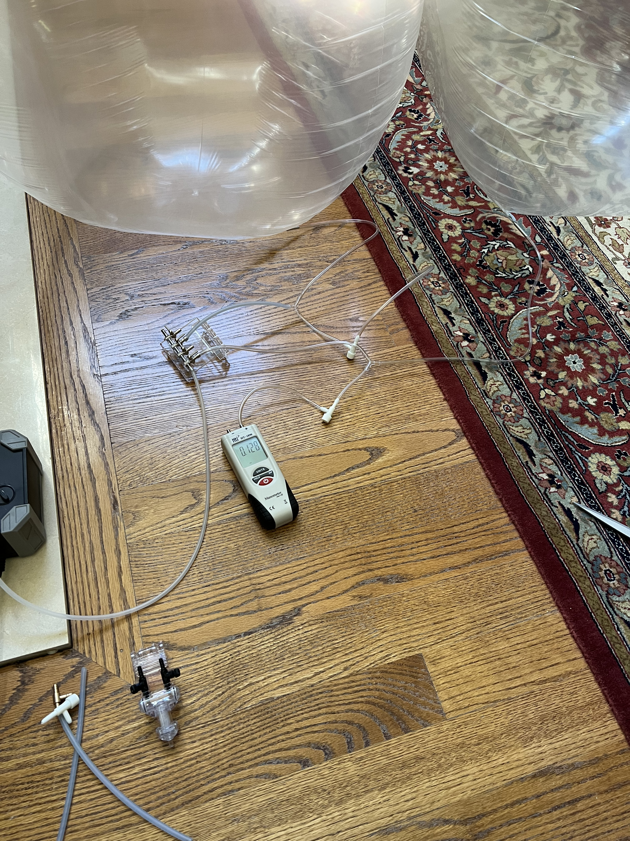
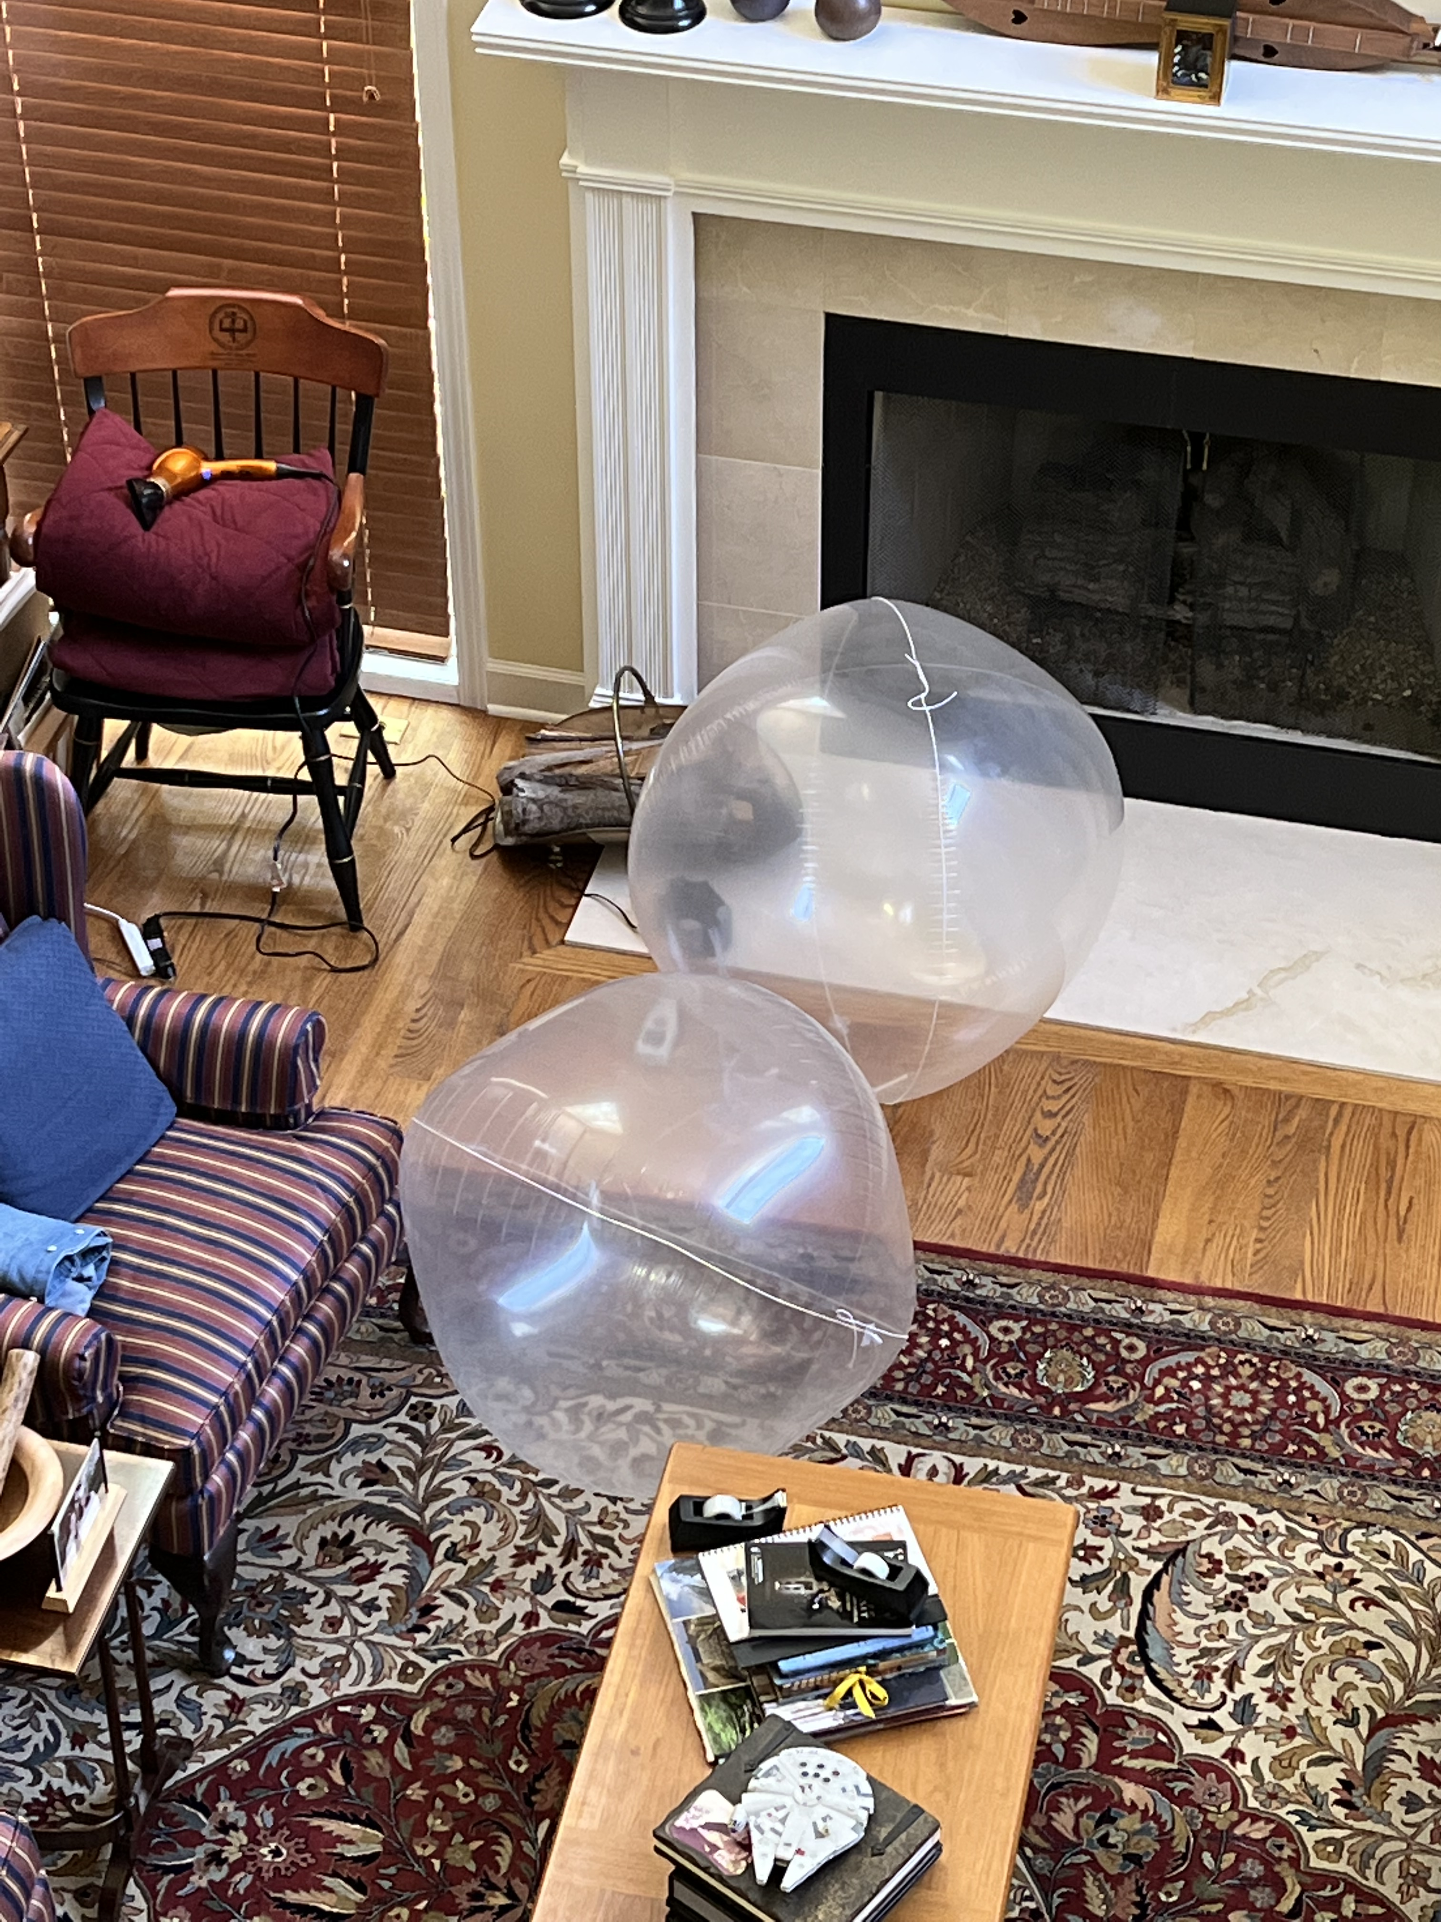
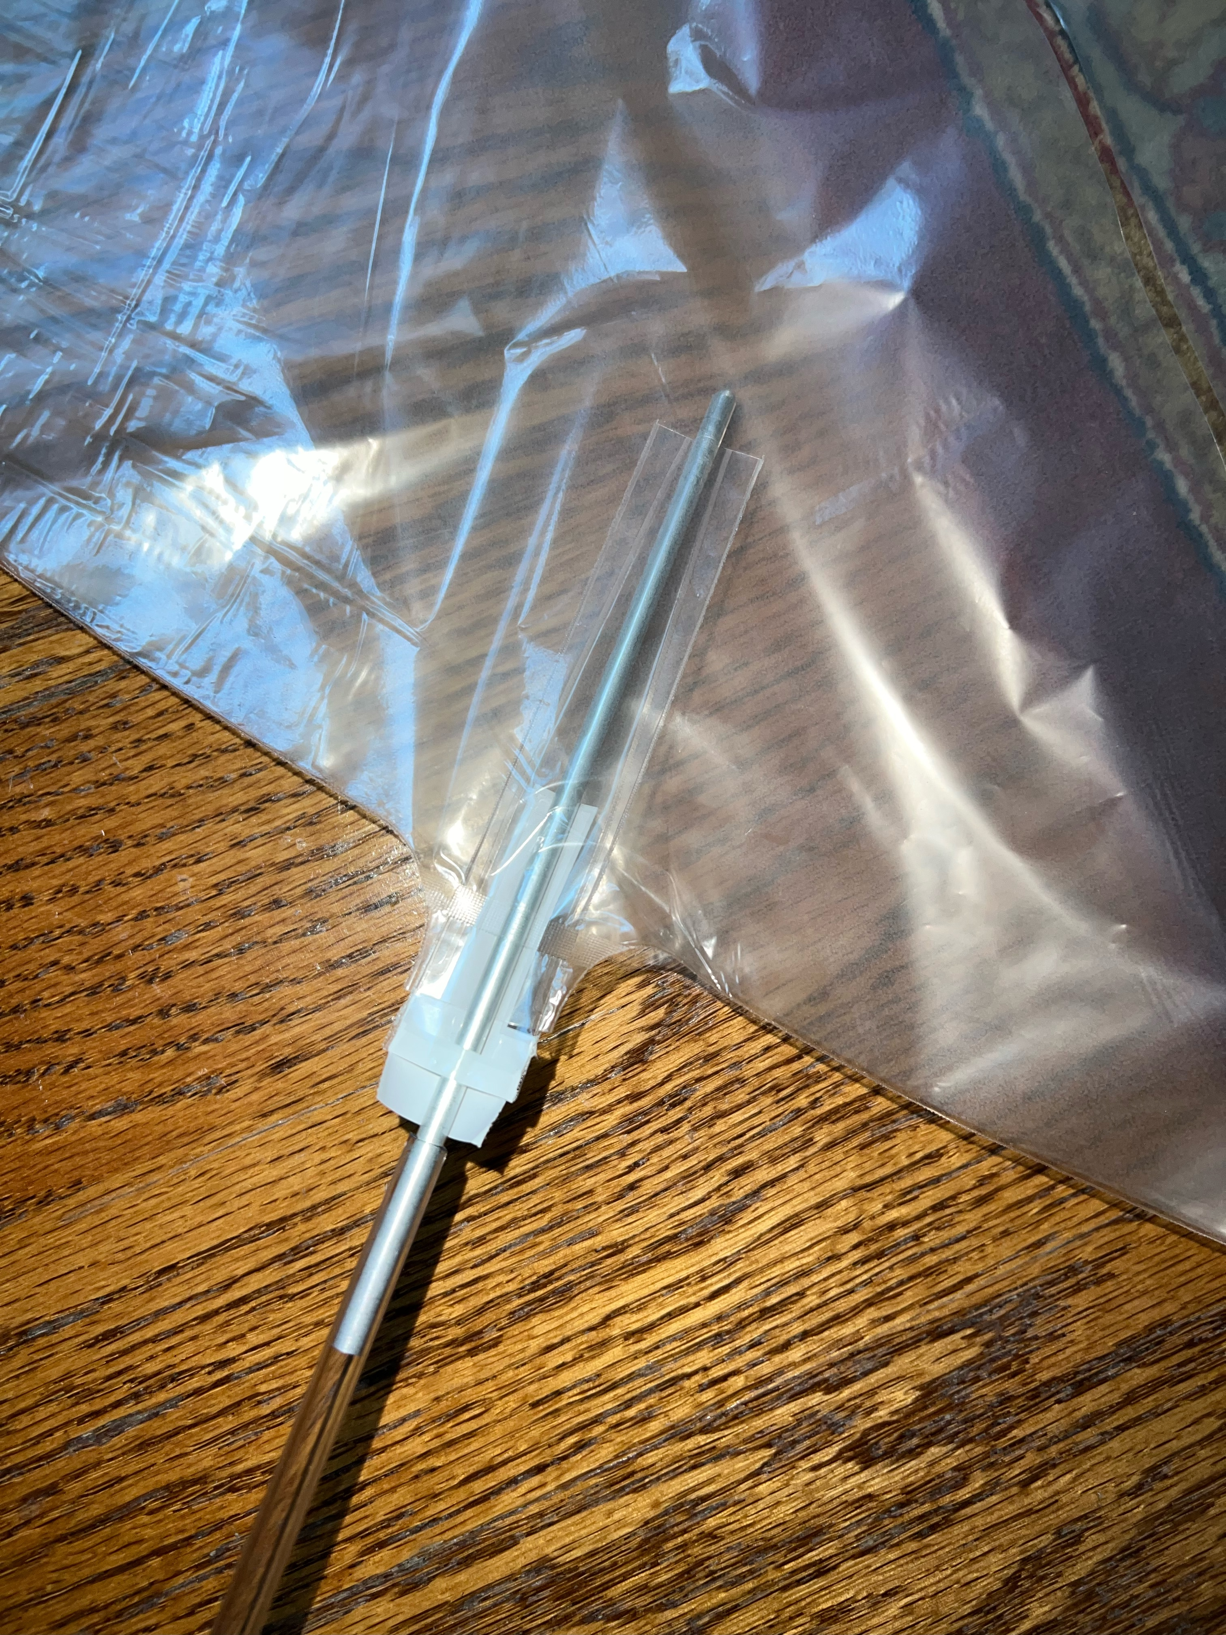
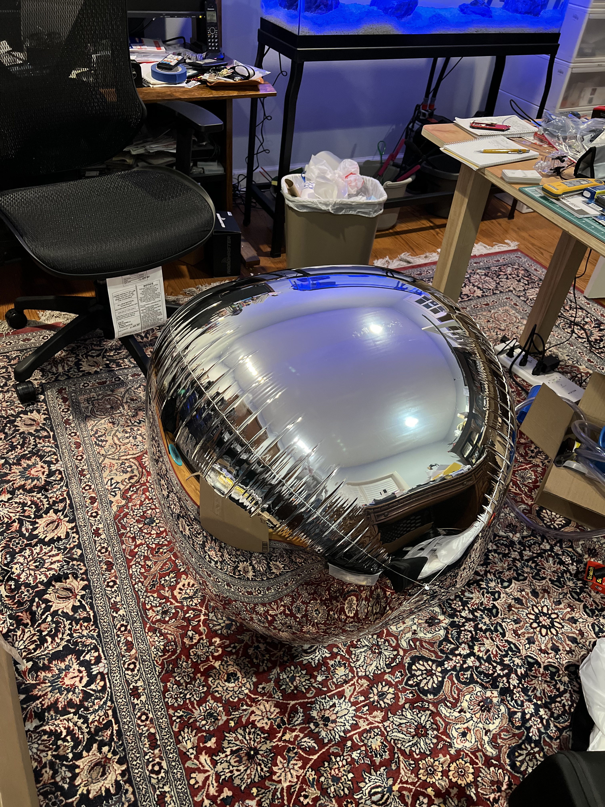
Balloon Pre-Stretch
Stewart, KB9LM is pre-stretching our balloons
Notice the gap between the fireplace and the Mantle
Notes:
Volume is the key – We stretch our balloons from about 90” circumference to 100”.

Slide 26
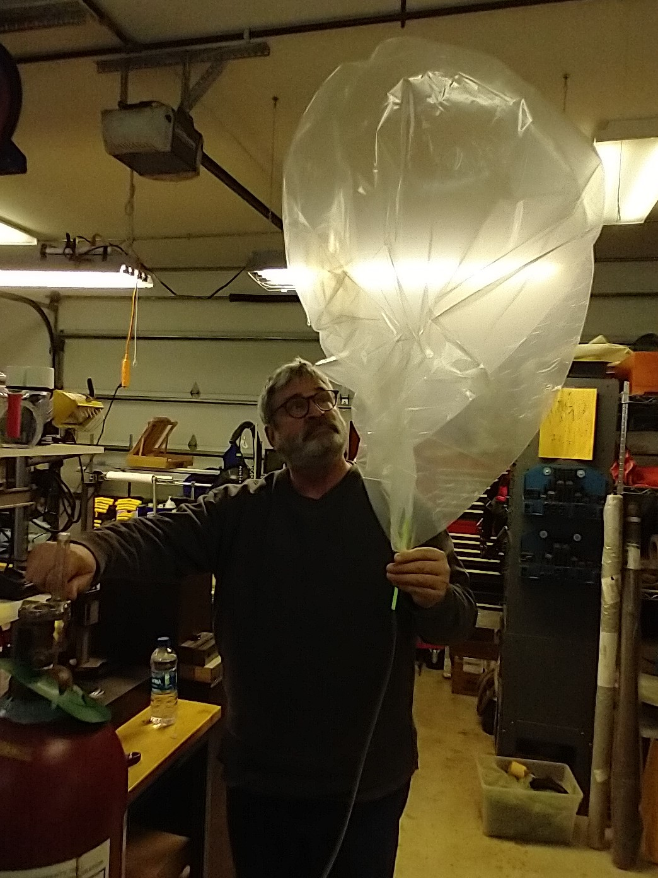
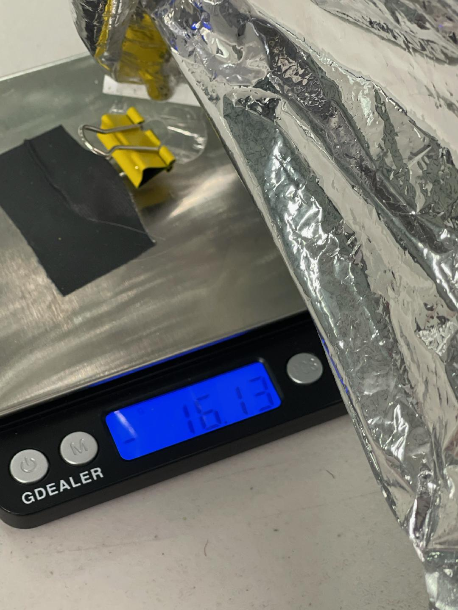
Balloon Fill
Once we calculate the amount of lift, we
1. Fill
2. Measure
3. Adjust
4. Go to 2
Notes:
Explain how we fill balloons
And, that at sea level, they leak

Slide 27
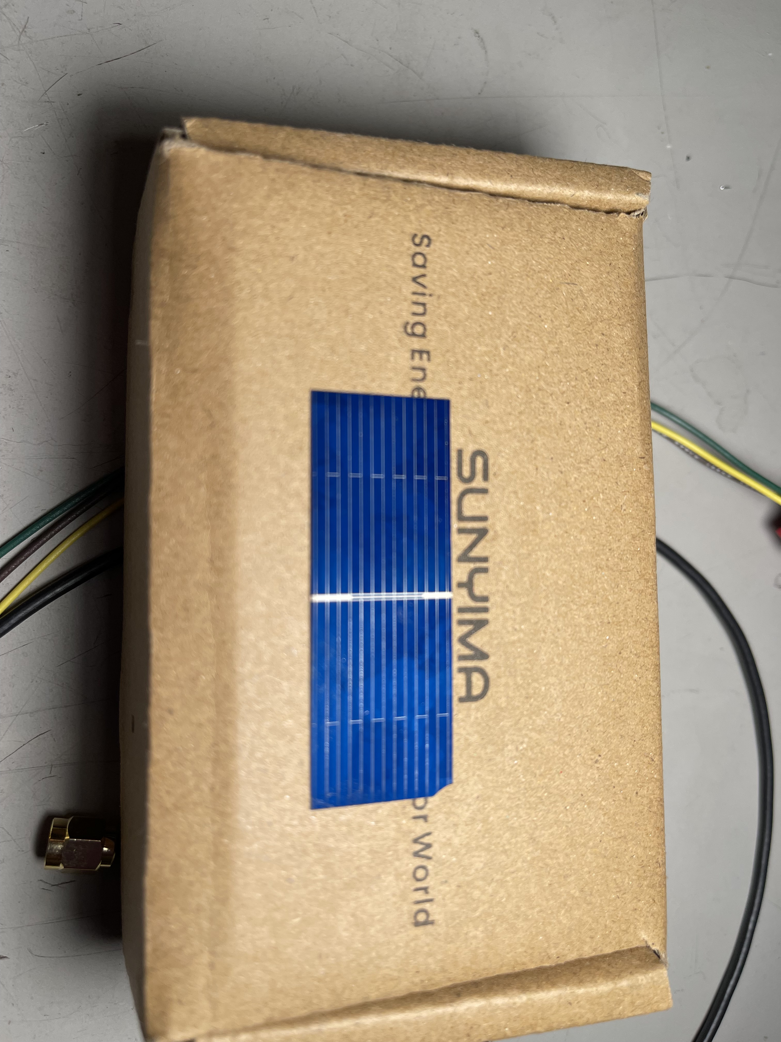
POLYCRYSTALLINE SOLAR CELLS
(Demo the cells)
Notes:
Small metalized connector that vaporizes if you try to solder it twice.
DEMO

Slide 28
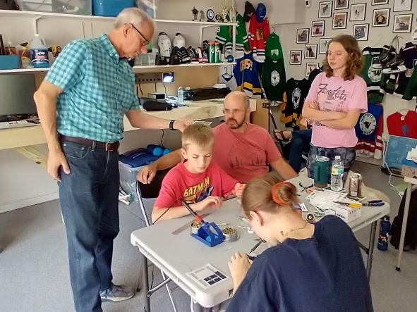
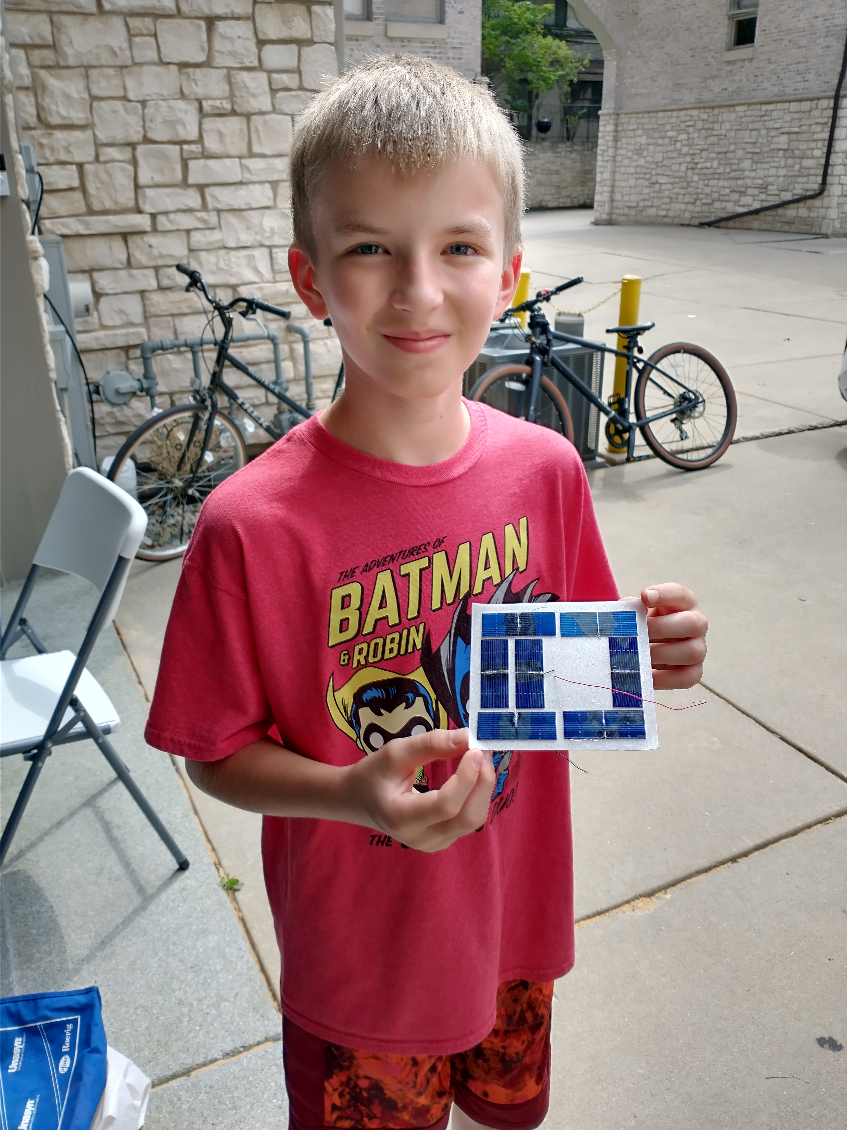
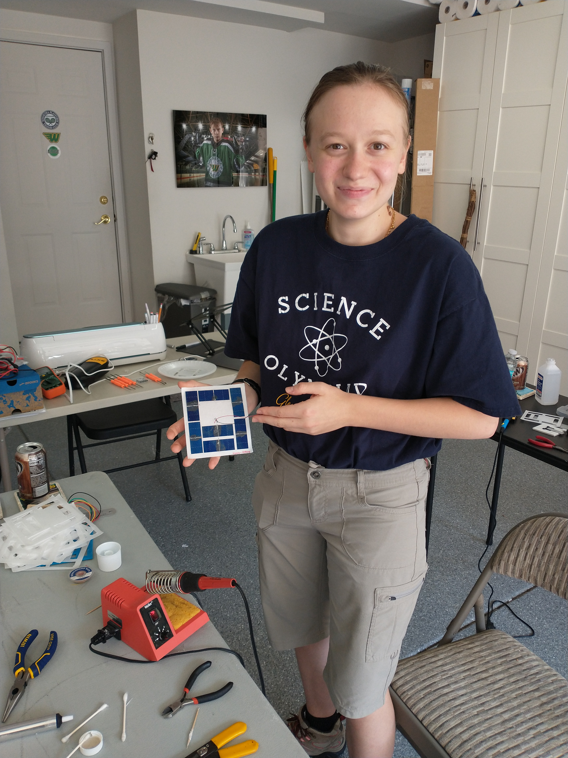
Solar Panel Assembly
Jim KD9UQB teaching the group
How to build solar panels
Gordie - KD9TVR
Mikaela KD9VIW
Notes:
We found out how to make solar panels – under aged labor

Slide 29
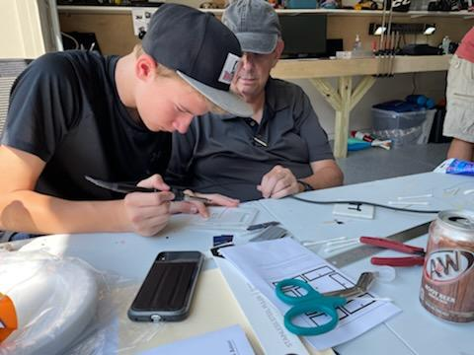
Noah KD9RDT and Cary KD9ITO Preparing Solar Panels

Slide 30
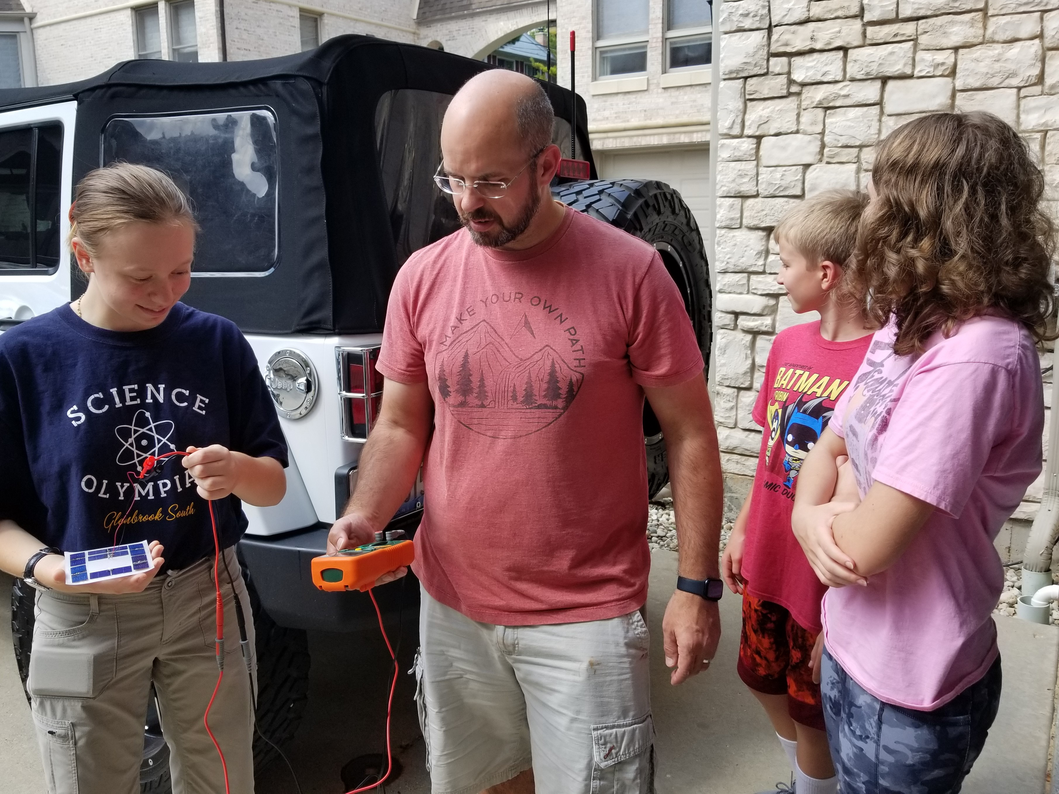
Doug KD9TPM, Kelsi KE9LSI, Gordie KD9TVR, and Mikaela KD9VIW testing a solar panel

Slide 31
OUR TRACKERS

Slide 32
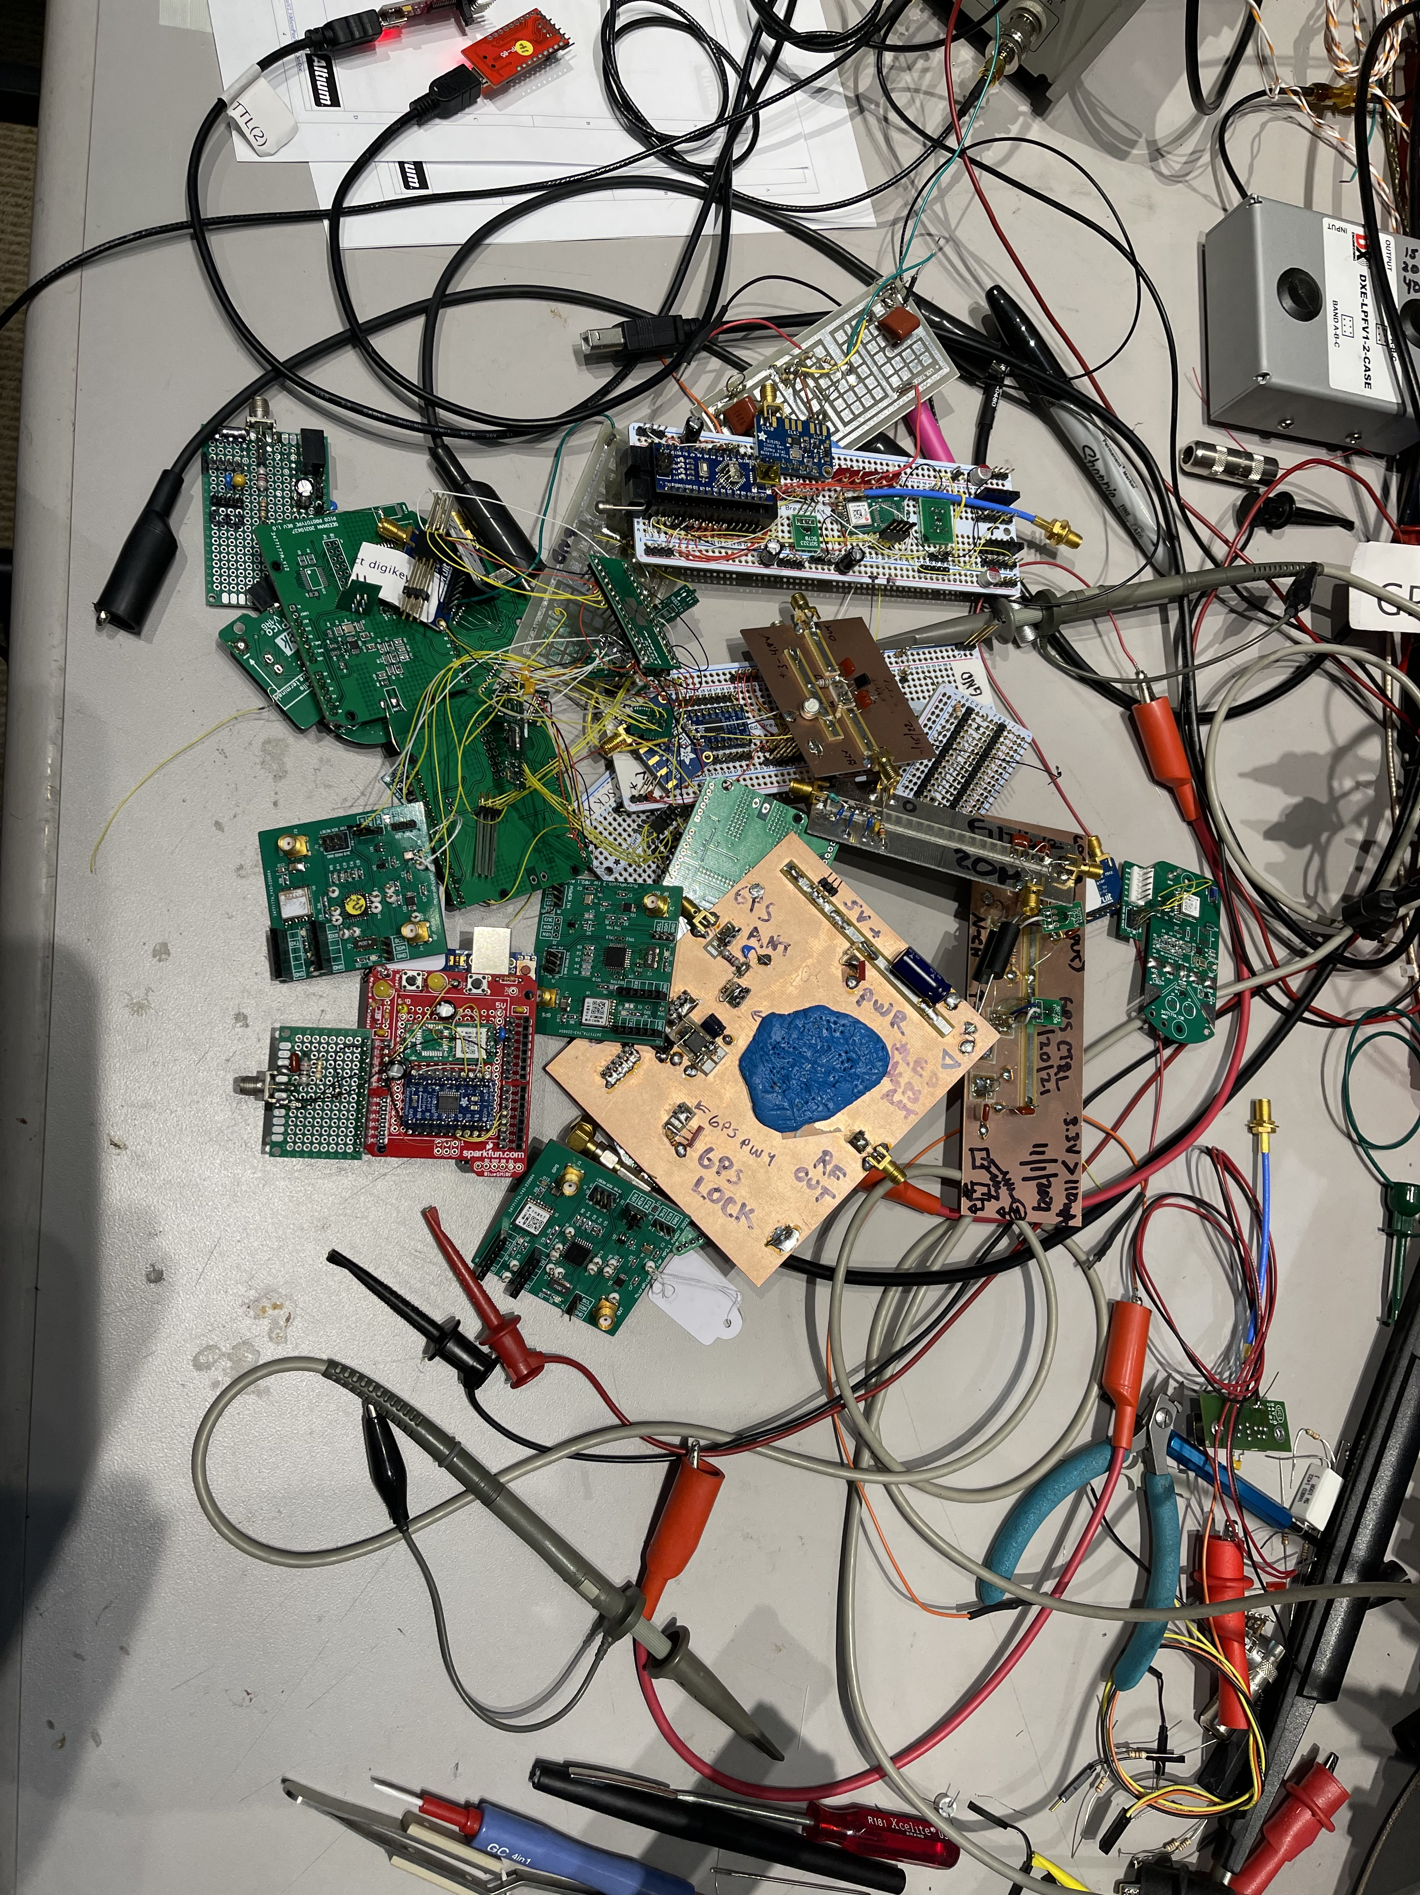

Slide 33
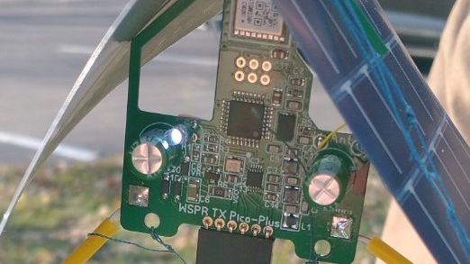
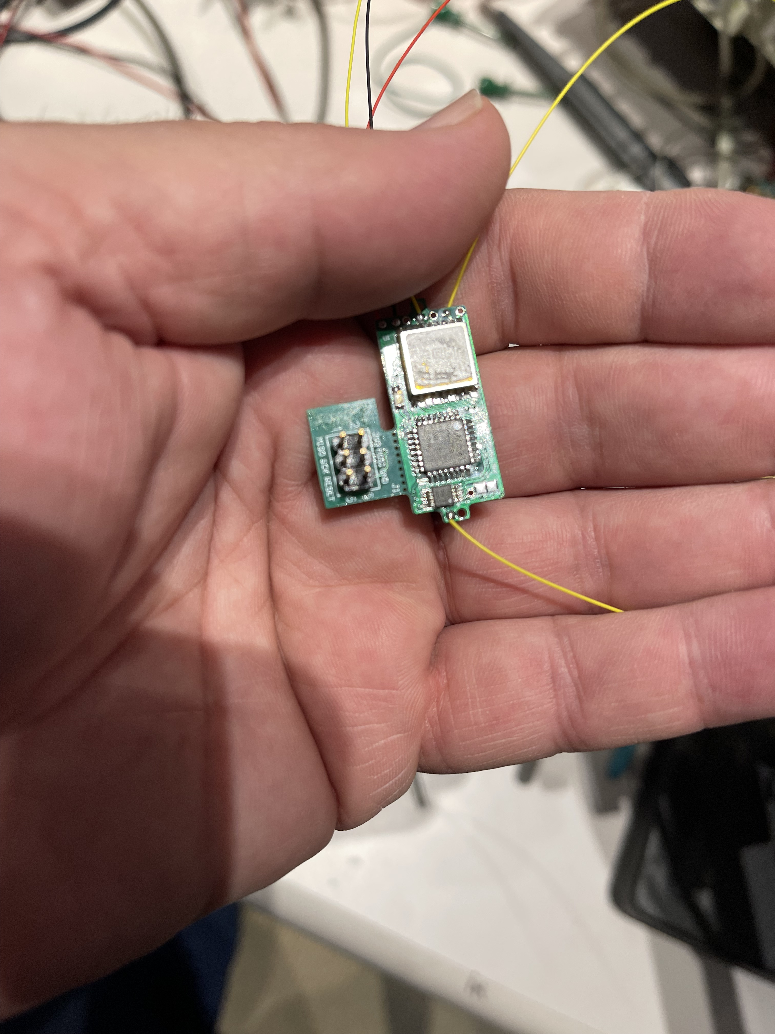
Trackers
Zachtek WSPR TX Pico-Plus tracker and solar panels
We flew this tracker for 19 of our 24 launches
Our HOMEBUILT V2.1 tracker
Flying at a balloon field near you
Notes:
A ZACHTECH board, complete with solar panels

Slide 34
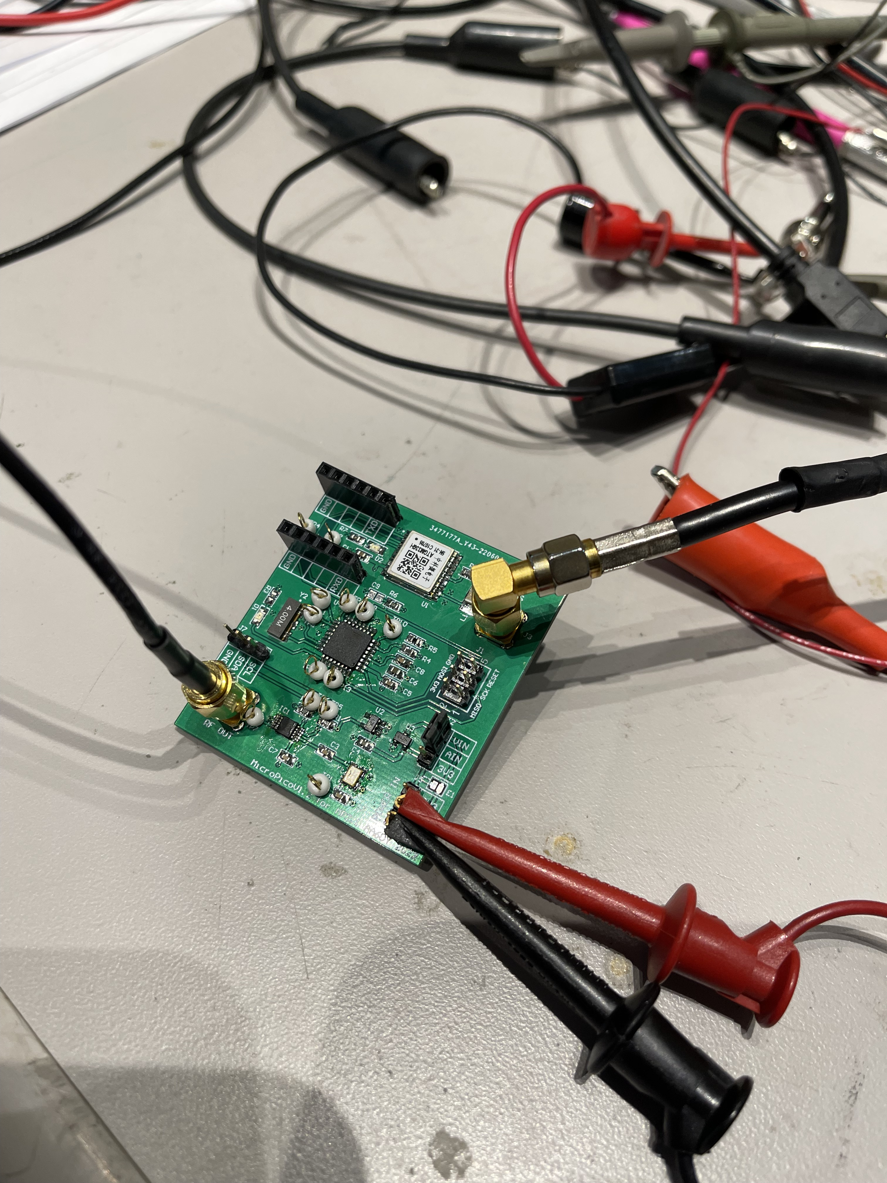
Trackers
Our prototype board - Not flown, but big enough to get your fingers and probes in there

Slide 35
Shhhhhhhh. WSPR.

Slide 36
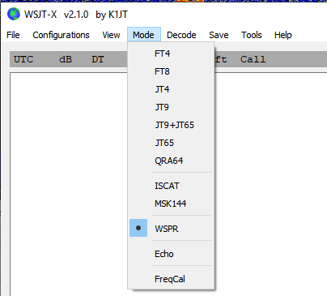
What is WSPR?
Similar to FT8 or JT65
2 minute transmission started on even minutes +- 2sec
Standard message format (50 bits)
28 bits for callsign, 15 bits for locator, 7 bits for power level,
One way beacon transmission
Used for testing antenna transmission or skip conditions
Notes:
WSPR
Long range
No coverage holes
Same frequencies world-wide
Limited telemetry
General license

Slide 37
Balloon Telemetry
Standard message: Callsign, Grid Square (4), Power
Send normal WSPR message followed by Telemetry message
Select an unassigned call prefix e.g T1, Qx2, 2x9
Encode data into the remainder bits (not characters)
Altitude
Fine location
Speed
Battery Voltage/Vcc
Temperature
Fine Altitude
Solar Radiation
Primary message
K9YO FN17 {17}
Rough Altitude
Telemetry message
T1{4ZQP} FN17 {43}
Temperature, Fine Altitude, Speed, Vcc, Radiation

Slide 38
WSPR
10mW is 2.25V p-p into 50 ohm. Which means when we
Transmit a wspr signal and someone 10,000 miles away hears it,
We’re getting the equivalent of ONE MILLION MILES PER WATT!

Slide 39
OUR FLIGHT PACKAGE

Slide 40
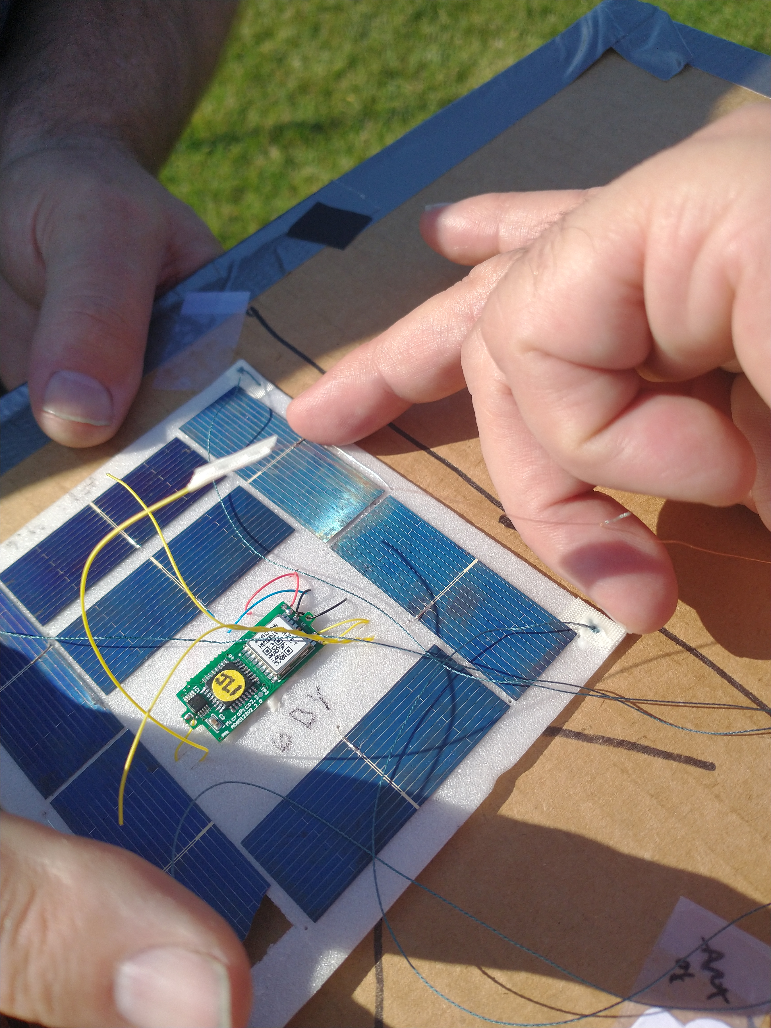
Our current design 7 polycrystalline solar panels and a tracker glued to a foam plate

Slide 41
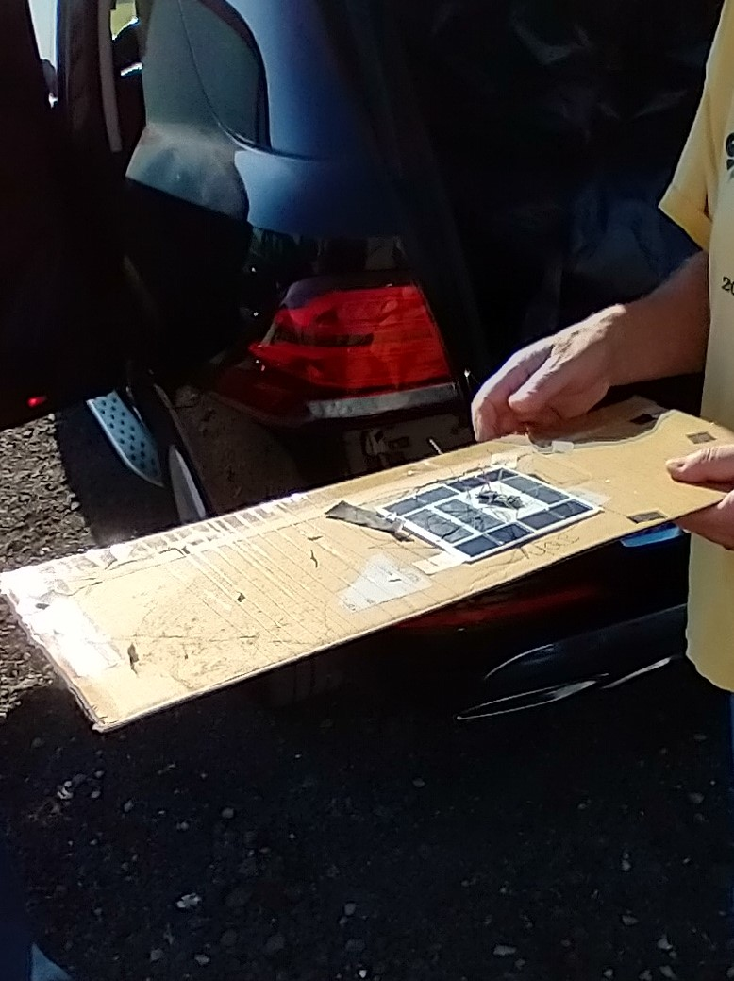
Notes:
We’re ready to go. ONE MORE PROBLEM TO SOLVE

Slide 42
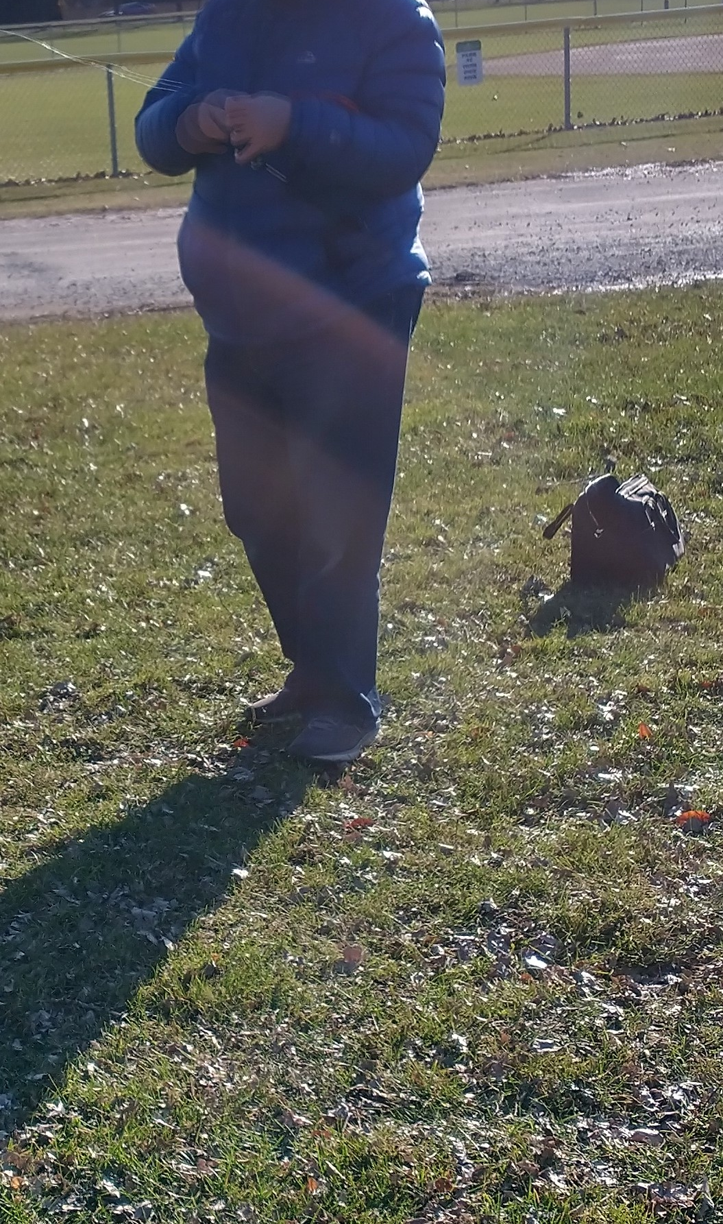
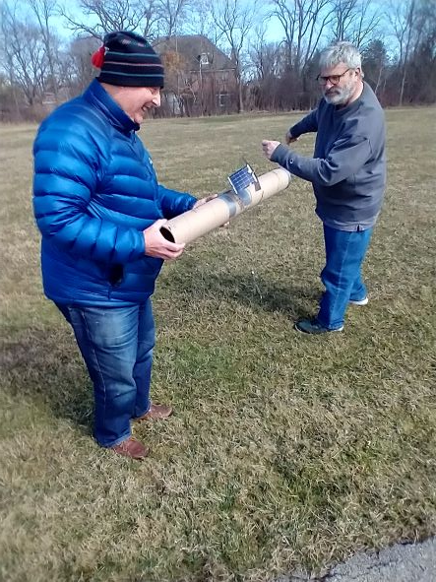
The Launch –
Don KK9H and Michael AA6DY
Unwinding the antenna from the package transport system (PTS)
Notes:
BUT THE PROBLEM IS, HOW DO WE STAY OUT OF THE TREES???

Slide 43
Icarus

Slide 44
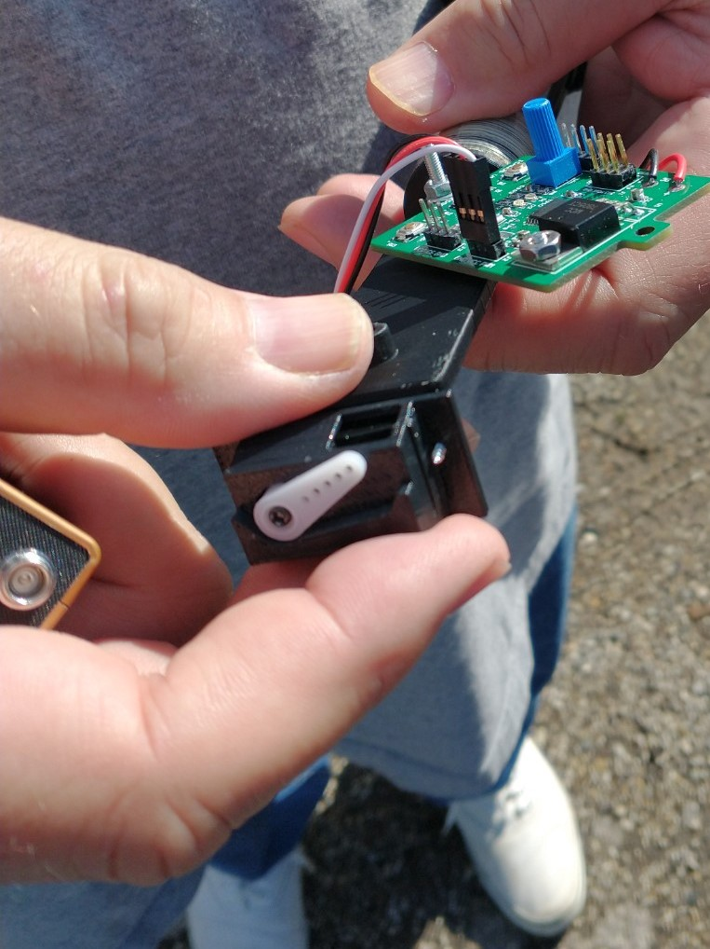

Slide 45
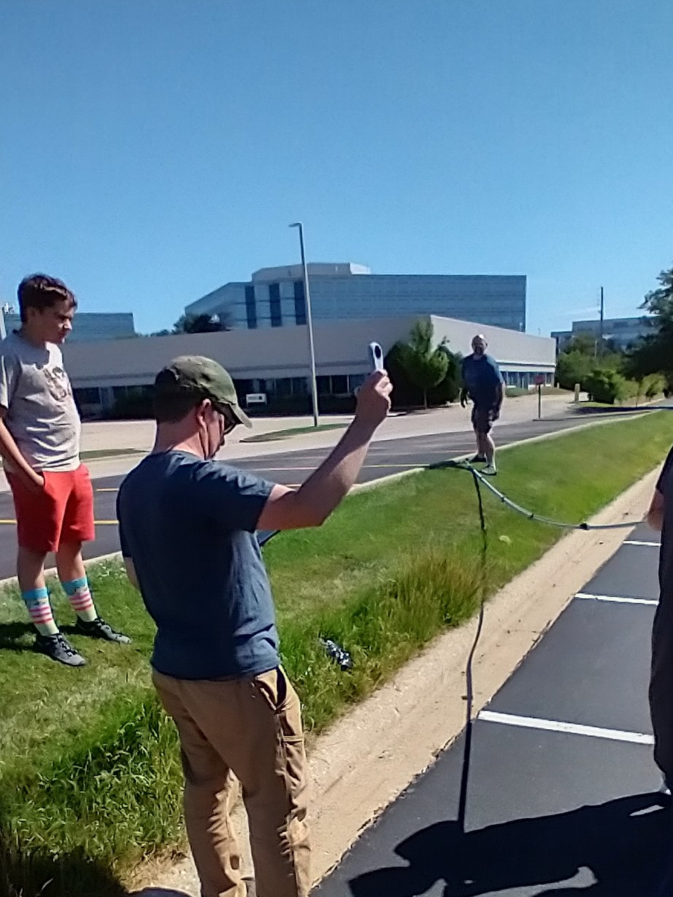
John, W9BLN checking wind speed
BTW –
John’s call is:
W9B a L loo N
how cool

Slide 46
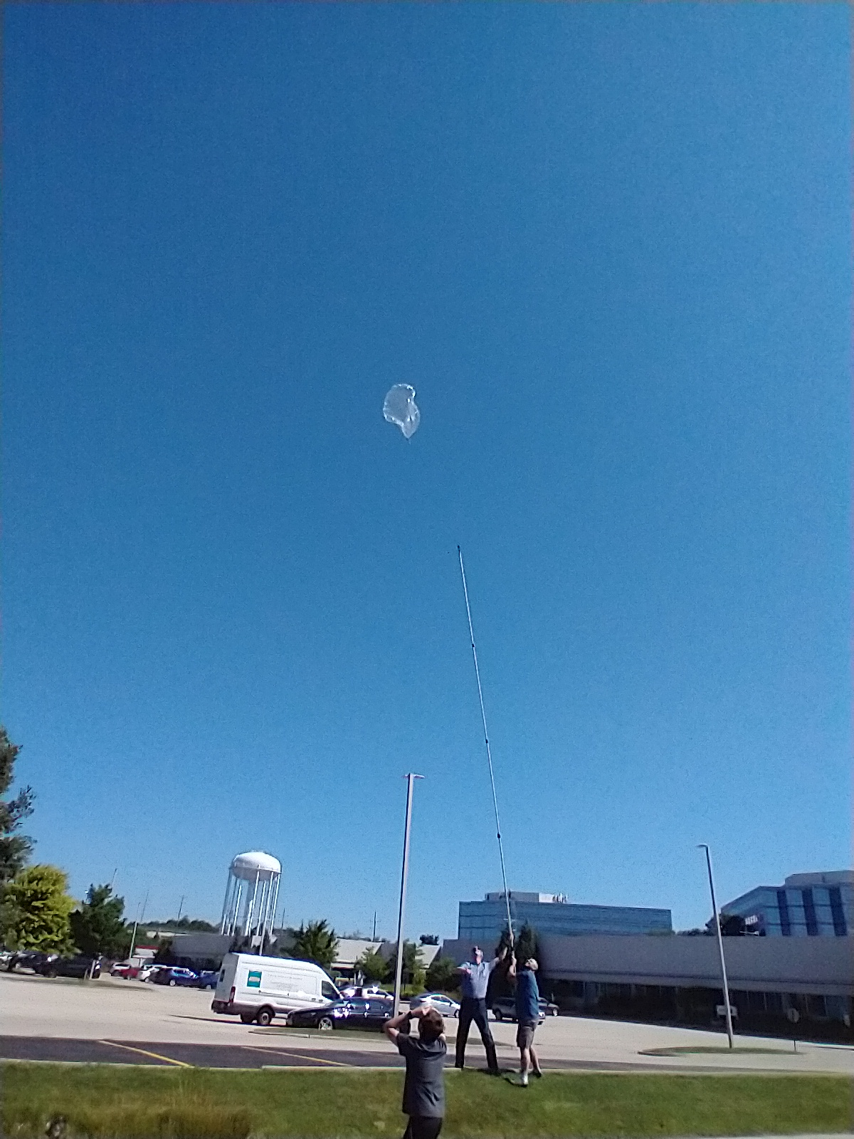
Notes:
Here’s our launch stick

Slide 47
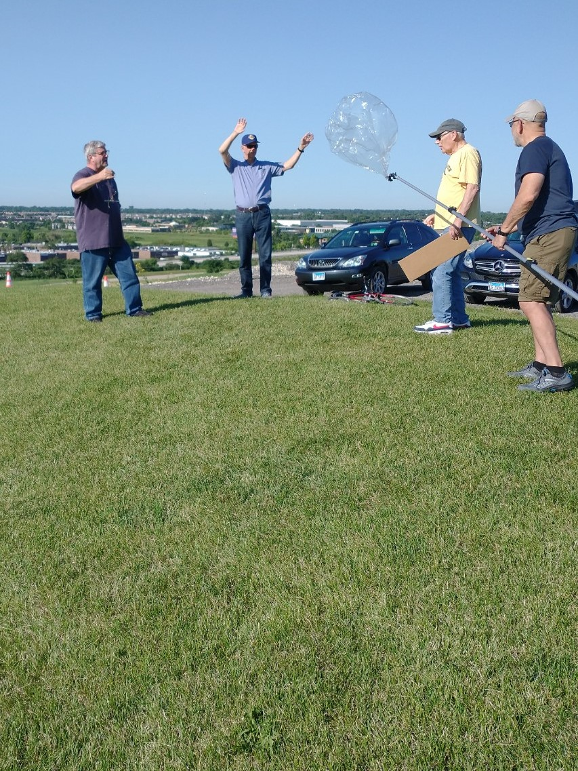
The Launch

Slide 48
Future Improvements
Notes:
MORE POWER

Slide 49
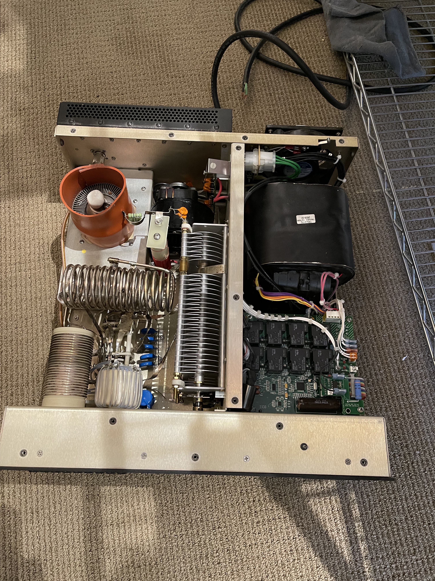
More Power

Slide 50
Why do we do this?
FIX THIS – NOTES ONLY
Cary Willis KD9ITO, 1st 9/25/21 didn’t leave Glencoe Beach (but did go up – very exciting). Qualex, Helium, Zachtek
Michael Seedman AA6DY, 10/2/21 - 1 day to Michigan, Qualex, Helium, Zachtek
Bob Berg KD9RDU, 10/23/21 – 1 day to Maryland Qualex, Helium, Zachtek
Cary Willis KD9ITO, 10/23/21 – Ft Wayne Indiana – Qualex, Helium, Zachtek
Jason Berg KD9CFM, 11/7/21 – Indiana Qualex, Helium, Zachtek
Doug Mulley KD9TPM 11/23/21 – Indiana Qualex, Helium, Zachtek
Casey KV3T – 12/12/21 – our first tree! looking up at the tree Qualex, Helium, Zachtek
Elizabeth Ziemer KD9ORR, 12/22/21 - 19 days – 8 days cruising the marshall islands. Chinese Pancake, Hydrogen, Zachtek
Casey KV3T – 1/16/22 no transmission received Chinese Pancake, Hydrogen, Zachtek
Burt Krain KR9T, 11th 1/26/22 - 10 days to Alaska – Double Chinese Pancake, Hydrogen, Zachtek
Happ Holly KC9RP - 2/8/22 – 3 days to Novia Scotia Chinese Pancake, Hydrogen, Zachtek
Don, KK9H – 4/1/22 2 days - Novia Scotia Chinese Pancake, Hydrogen, Zachtek
KD9ITO – 4/15/22 Chinese Pancake, Hydrogen, Zachtek
Don, KK9H – 5/4/22 – 1 day - East Coast Chinese Pancake, Hydrogen, Zachtek
AA6DY – 5/4/22 – no transmission received Chinese Pancake, Hydrogen, Zachtek
AA6DY – 6/11/22 – no transmission received SAG Balloon, Hydrogen, U4B tracker
KD9ITO – 6/11/22 – no transmission received SAG Balloon, Hydrogen, Zachtek
John Walsh – 6/19/22 W9BLN – 10 day flight to Gulf of Mexico and up to Novia Scotia U4B tracker, Pancake, Hydrogen
Stewart Spies 6/19/22 KB9LM – 10 day flight to Gulf of Mexico, then on to Mexico drinking margaritas from the top of a tree Pancake, Hydrogen NIBBB Tracker
Doug Mulley – KD9TPM 7/31/22. 10 days, Around the World to North Pacific Ocean. Pancake balloon, Hydrogen, NIBBB Tracker, ICARUS
Jim Janiak – KD9UQB 7/31/22. No transmission received, SAG balloon, Hydrogen NIBBB Tracker, ICARUS
Jim Janiak – KD9UQB 9/3/22. No transmission received, Yokohama, Hydrogen NIBBB Tracker, ICARUS
Michael Seedman – AA6DY 9/3/22 – MIA over Moldovia, could be over china, Yokohama, Hydrogen NIBBB Tracker, ICARUS
Bill Fiely
Henry Fiely KD9SRZ Tech License
Noah Berg KD9RDT Tech License
Wendy Berg KD9RDV Tech License
Kelsi Mulley KE9LSI General License
Gordie Mulley KD9TVR General License
Ken Daniel K9YO member
Mikaela Streicher KD9VIW member

Slide 51
Because we’re HAMS
AND THAT’S WHAT WE DO

Slide 52
More?
Visit NIBBB.ORG
Or see
Cary, KD9ITO

